Slide 1

ENTERPRISE ACADEMIC SOFTWARE
Library Management System
Automated cataloging, circulation tracking, and digital resource orchestration for modern academic institutions.

Slide 2
System Impact & Operational Scale
50,000+
99.8%
24/7
Indexed Volumes
Circulation Accuracy
Digital Portal Access
Instant ISBN cataloging and search.
Automated barcode issue and return.
Online reservations and e-journal lookup.

Slide 3

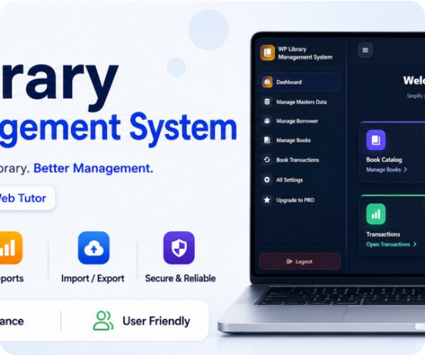
Smart Catalog & Member Portal
Real-Time OPAC Search
Filter books by title, author, ISBN, or shelf availability.
Self-Service Reservations
Students reserve titles online with automated pickup alerts.
Automated Fine Calculation
Transparent overdue tracking and digital receipt generation.

Slide 4


Barcode Circulation & Inventory
Instant Check-Out & Return
Sub-second barcode scanning links student IDs to book copies.
Live Stock Audits
Track issued, overdue, damaged, and available copies effortlessly.
Automated SMS & Email Reminders
Proactive due-date notifications reduce late book returns.

Slide 5
Core Architecture Modules
Cataloging
Member Management
Analytics & Reports
MARC21 & ISBN metadata indexing.
Student & faculty borrowing quotas.
Circulation trends & audit exports.

Slide 6

Empowering Academic Knowledge Discovery
Library Management System — Project Documentation & Architecture Overview

Slide 7



Image Sources
https://img.asumag.com/files/base/ebm/asumag/image/2026/10/6acfb348dd36c6174ea63cd1-oakton_skokie_5.png?auto=format,compress&fit=crop&q=45&h=356&height=356&w=640&width=640
Source: www.asumag.com
https://ps.w.org/library-management-system/assets/banner-1544x500.jpg?rev=3620837
Source: wordpress.org
https://www.satoamerica.com/adobe/dynamicmedia/deliver/dm-aid--59d74c07-a0f1-49f0-ae8c-32ed93fb8414/library-scanbooks.jpg?preferwebp=true&quality=85
Source: www.satoamerica.com

